Slide 1
Farm Equipment Rental Management System - Phase I PowerPoint Presentation

Slide 2
FARM EQUIPMENT RENTAL MANAGEMENT SYSTEM
PL/SQL Oracle Database Capstone Project
INSY 8311 - Database Development with PL/SQL
Student: Teta kevine
Student ID: 27973
Date: November 17, 2025
Adventist University of Central Africa (AUCA)
Lecturer: Eric Maniraquha

Slide 3
Problem Definition
PROBLEM STATEMENT
Challenge:
• Small-scale farmers cannot afford expensive farm equipment
• Equipment underutilization for owners/dealers
• Manual rental processes cause scheduling conflicts
• No centralized system for maintenance tracking
Impact:
• Reduced agricultural productivity
• Higher operational costs
• Equipment downtime inefficiencies
• Lost revenue opportunities

Slide 4
Context & Users
    SYSTEM CONTEXT & TARGET USERS
Where/How Used:
• Agricultural cooperatives in Rwanda
• Equipment rental depots in rural areas
• Online/web-based access for reservations
• Mobile-friendly for remote farmers
Primary Users:
1. Farmers/Renters - Browse & reserve equipment
2. Equipment Owners - Manage inventory & revenue
3. Depot Managers - Oversee operations
4. Maintenance Staff - Schedule servicing
5. Administrators - System management

Slide 5
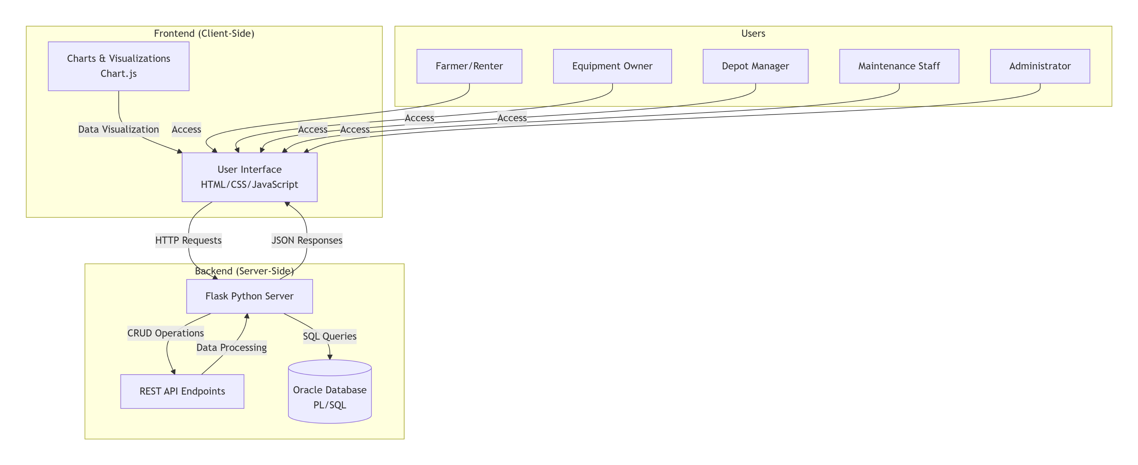
System architecture

Slide 6
Project Goals
      PROJECT OBJECTIVES & OUTCOMES
Primary Goals:
✓ Streamline rental booking process
✓ Track equipment availability in real-time
✓ Automate payment and billing
✓ Schedule preventive maintenance
✓ Generate analytical reports
Expected Outcomes:
• 50% reduction in scheduling conflicts
• 30% increase in equipment utilization
• Automated revenue tracking
• Predictive maintenance alerts
• Enhanced customer satisfaction

Slide 7
BI Potential
BUSINESS INTELLIGENCE OPPORTUNITIES
Analytics for Decision-Making:
1. Equipment Utilization Analytics
- Peak demand periods identification
- Underutilized equipment optimization
2. Revenue Forecasting
- Seasonal revenue predictions
- Pricing optimization models
3. Maintenance Cost Analysis
- Preventive vs reactive cost comparison
- Downtime impact on revenue
4. Customer Behavior Insights
- Rental pattern analysis
- Customer retention strategies
5. Operational Efficiency
- Depot performance metrics
- Resource allocation optimization

Slide 8
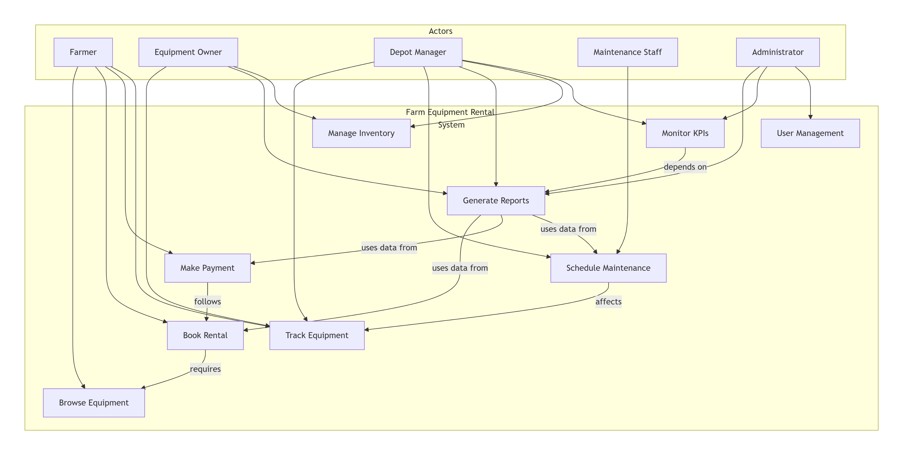
Power bI

